Slide 1

VAKRATUND CONSTRUCTION
VC
VAKRATUND CONSTRUCTION
COMPANY PROFILE

Slide 2

INDEX
VC
ABOUT US
BACKGROUND
OUR MISSION
SAFETY
LIST OF EQUIPMENTS AND INSTRUMENTS
OUR ESTEEMED CLIENTS
VAKRATUND CONSTRUCTION

Slide 3

About Us
QUICK GLIMPSE
Our company is a sole proprietorship company.
Our office is situated at Laxmi – Narayan building, Dhadge mala, Chakan.
We carry out all civil related works for residential as well as industrial clients and we also work as government contractors.
We promise quality work within the given time and within the prescribed budget.

Slide 4

Background
VC
Vakratund Construction was established in 2007.
From then till now we have carried out a numerous projects for residential as well as industrial clients .
In year 2016 we started our work as government contractors and carried out projects for various government bodies.
Architectural craftsmanship, engineering, integrity, honesty, and quality workmanship are what we have built our reputation on since last one decades .

Slide 5
Our Mission
VC
SAFETY-PRODUCTIVITY-EFFICIENCY
To perform for our customers the highest level of quality construction services at fair and market competitive prices.
To ensure the longevity of our company through repeat and referral business achieved by customer satisfaction in all areas including timeliness, attention to detail and service-minded attitudes.
To maintain the highest levels of professionalism, integrity, honesty and fairness in our relationships with our suppliers, subcontractors, professional associates and customers.
To ensure latest technologyis incorporated in to our Tools, Techniques and Methodologiesused to deliver high-quality services to our customers ensure continuous process improvement.

Slide 6
SAFETY
VC
Our mantra is: “Every worker goes home from each of our jobs, every day.”
We have developed a culture that promotes an injury-free environment and provides the safest workplace possible for our employees, subcontractors, clients and others who enter or who are near our construction.
We are dedicated to elevating the standards for safety in the construction industry through a wide variety of methods—from zero-tolerance drug testing to our aggressive fall-protection program, which includes partnering with the leaders in the insurance industry to develop the next generation of fall-protection systems.
Through innovative training and education programs, we also provide our employees and subcontractors with the tools, knowledge and resources they need to increase safety, reduce risk and improve loss control on every project we manage.

Slide 7
List of Instruments and Equipments
VC
Equipment's and instruments make wonders happen.
Description | Units/Sets
Ready Mix Concrete Plant | 1
Transit Mixer | 5
Vibratory Roller 8 ton | 2
Hywa | 3
Grader | 1
Back Hoe Loaders (JCB) | 3
Pocklain 210 | 2
Tractors and trolleys | 2

Slide 8
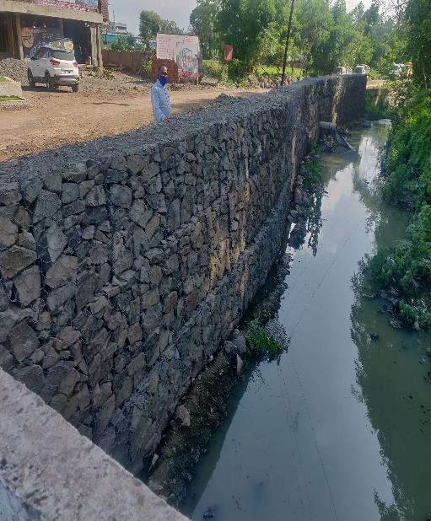
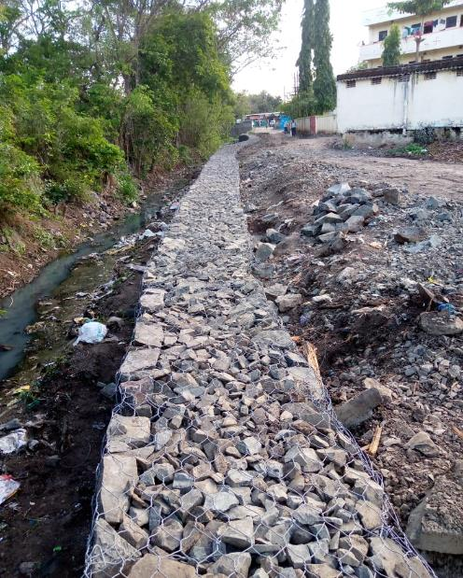
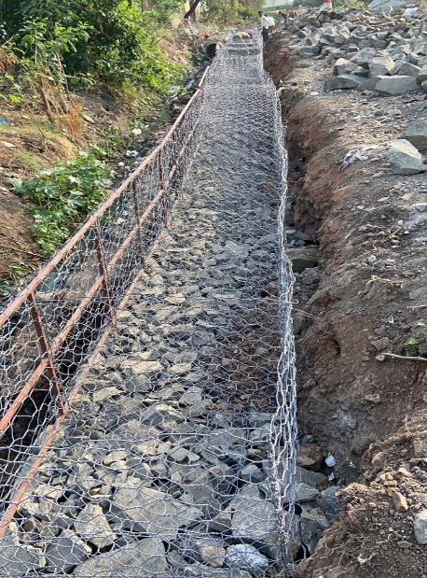
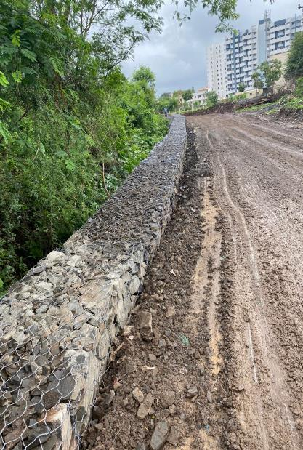
Types of Works Executed
VC
Gabion Wall Construction

Slide 9
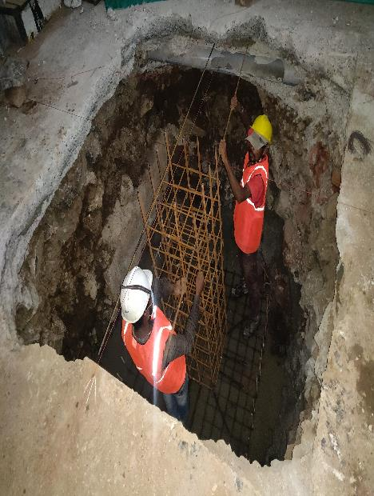
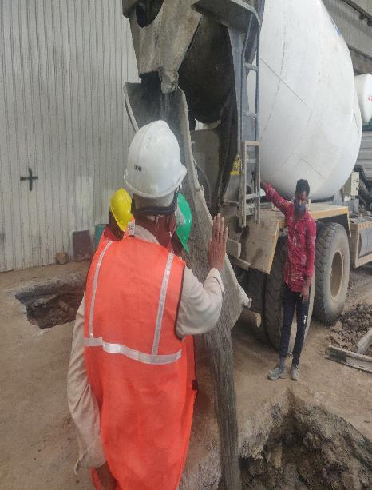
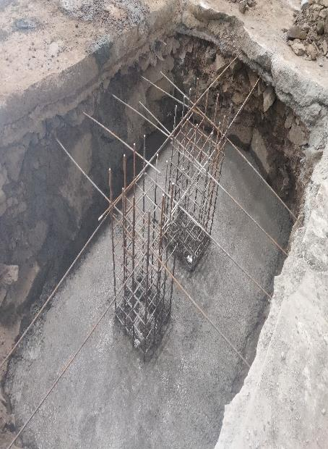
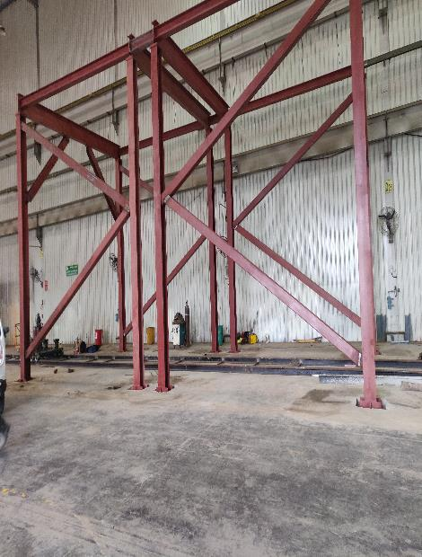
VC
Machine Foundations and Fabrications

Slide 10
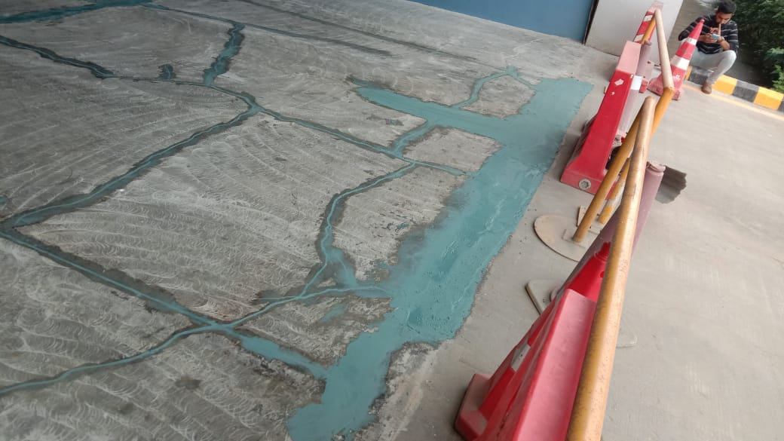
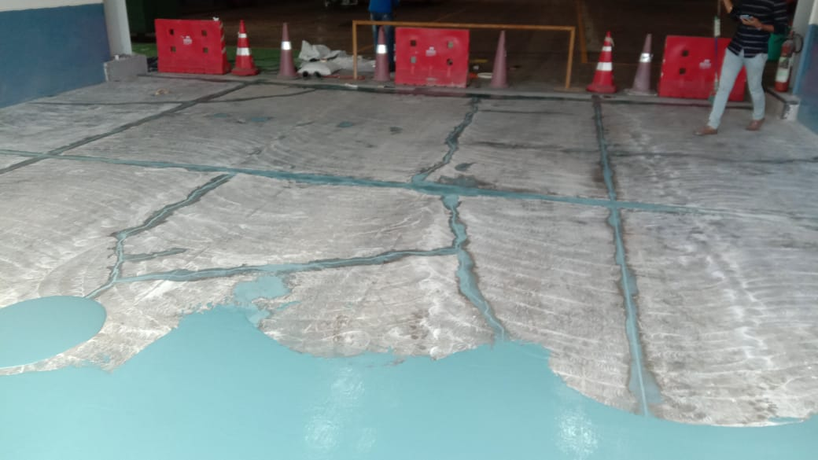
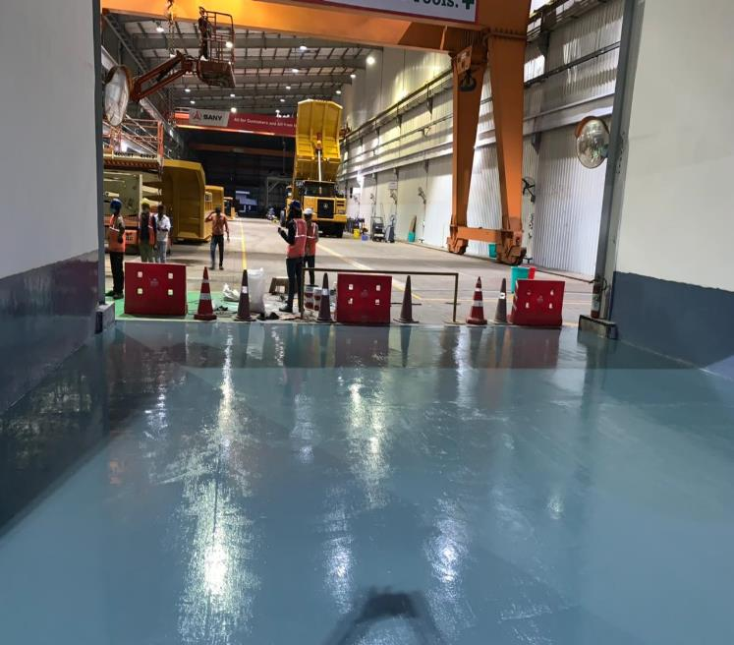
VC
Floor Maintenance and Epoxy

Slide 11
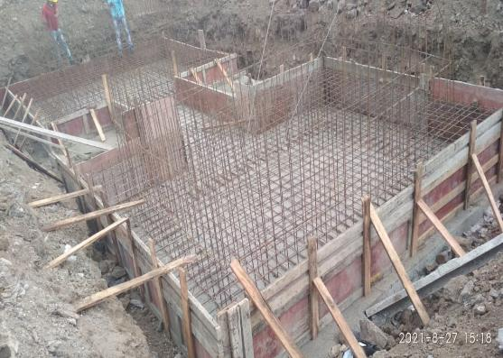
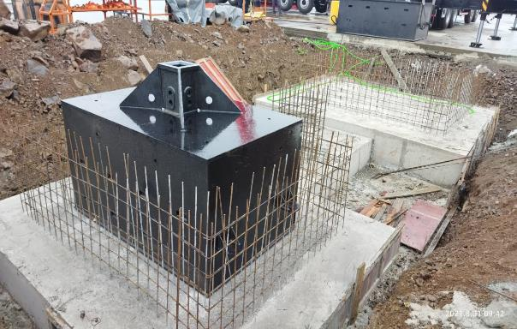
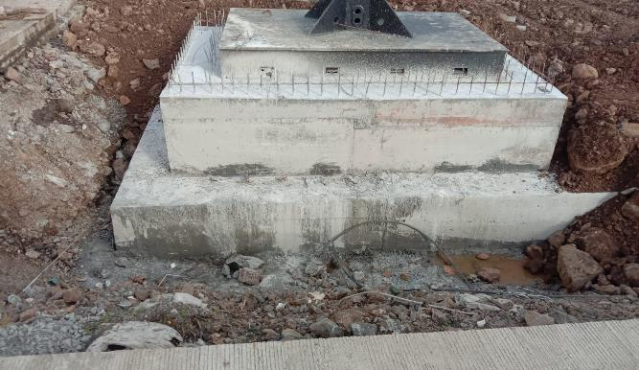
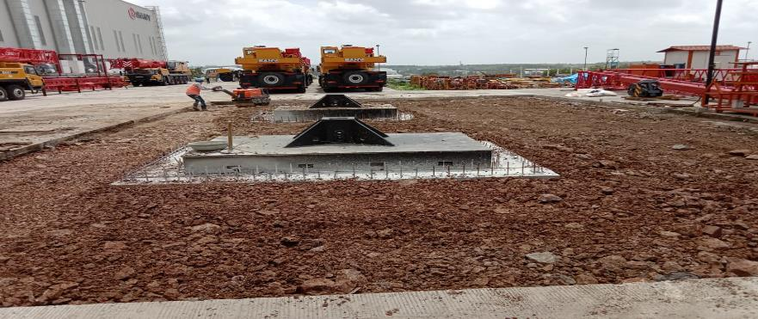
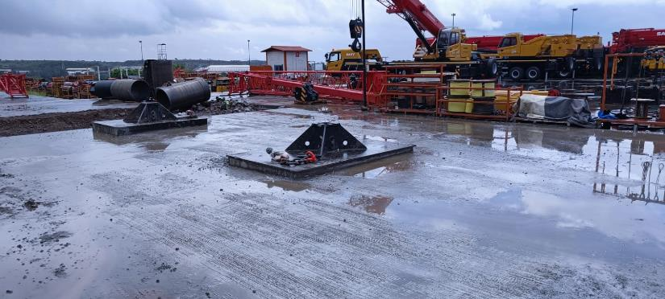
VC
Special Foundations

Slide 12
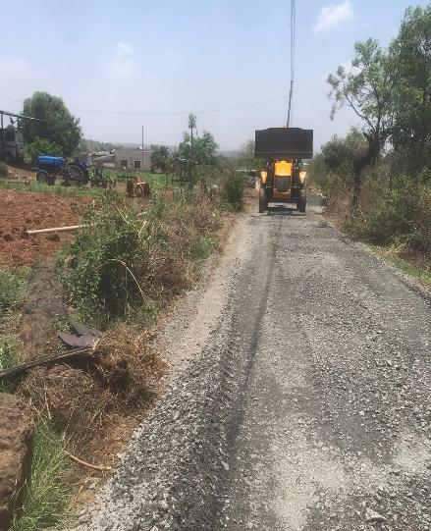
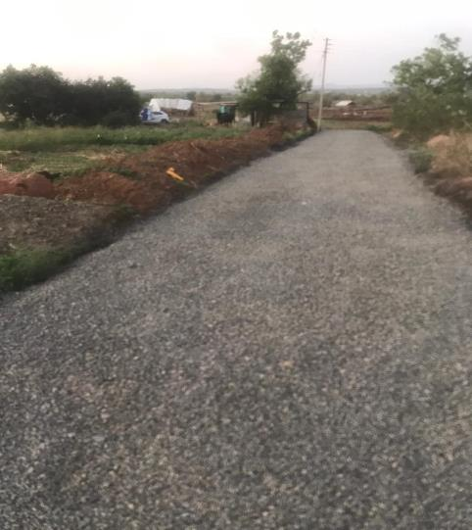
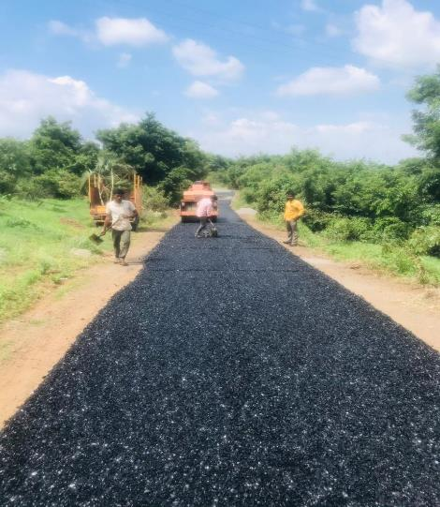
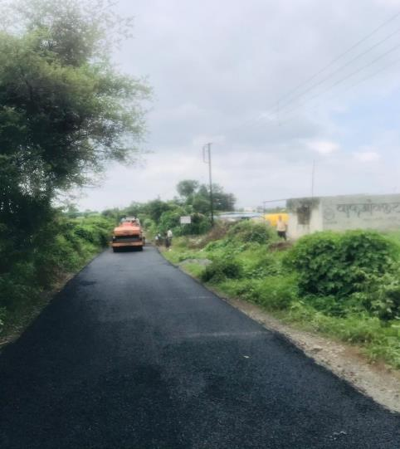
VC
Bitumen Road Constructions

Slide 13
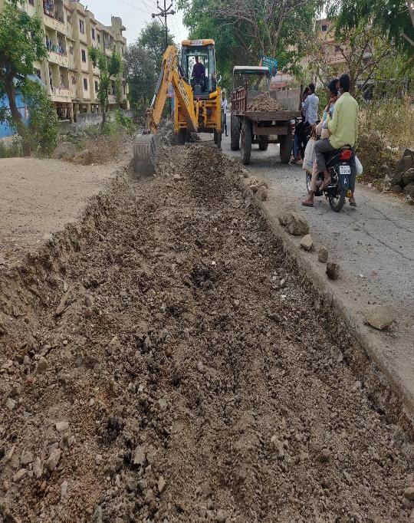
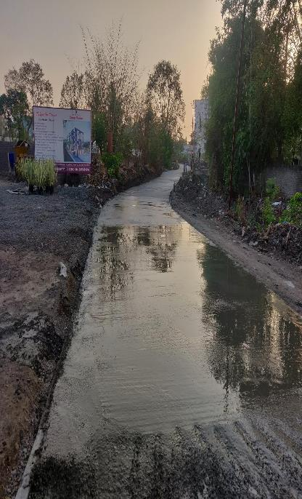
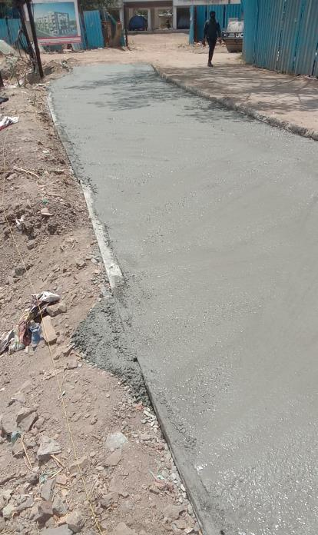
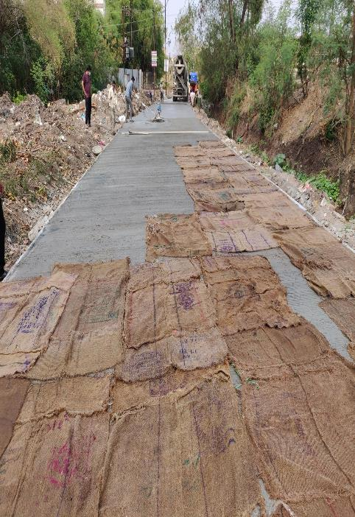
VC
Concrete Roads

Slide 14
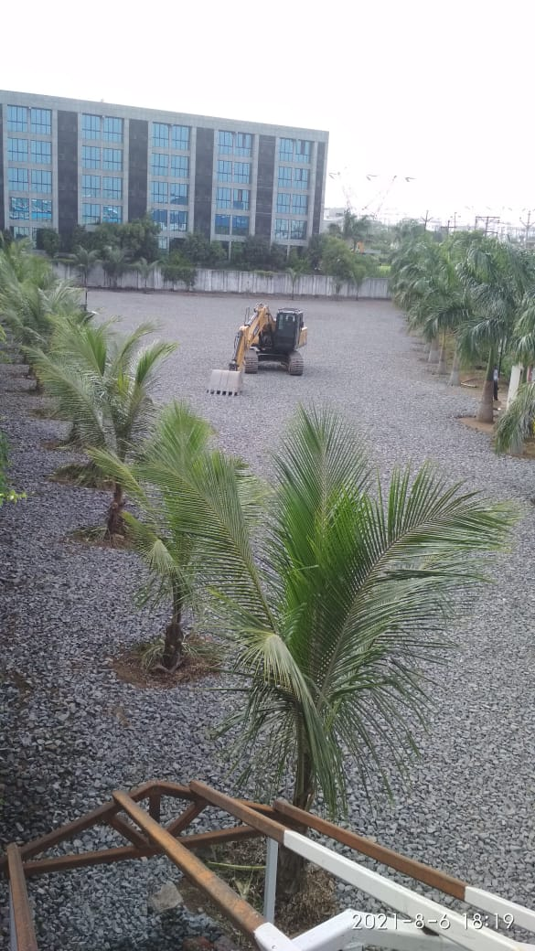
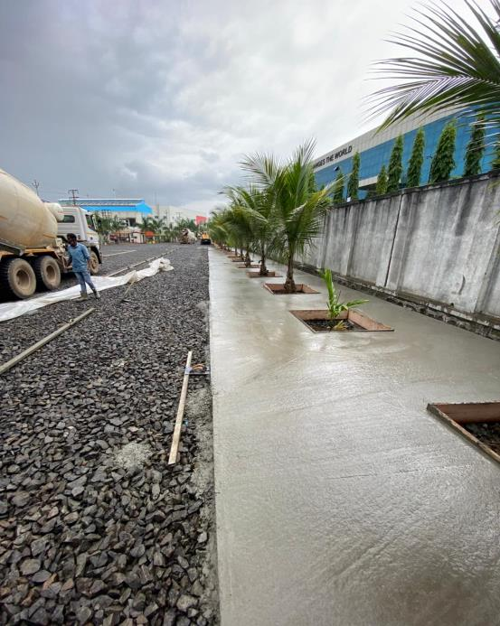
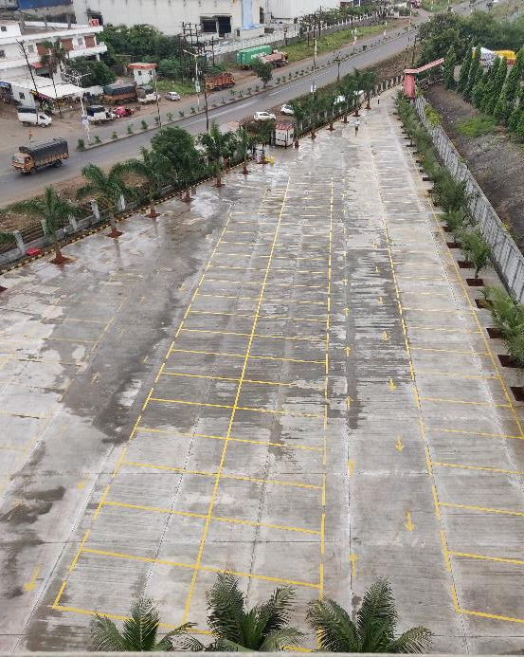
VC
Parking Construction with Thermoplastic Paints and Signs

Slide 15
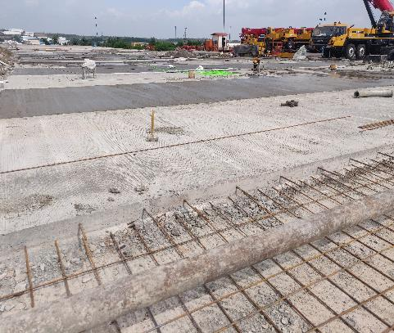
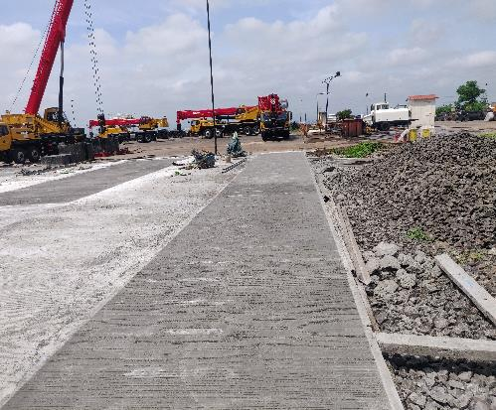
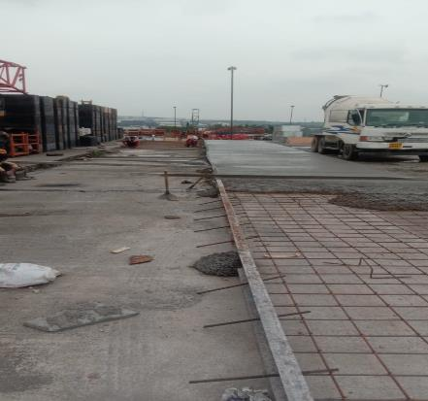
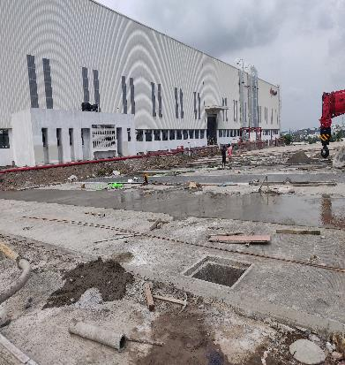
VC
Mass Concrete
And Many More…
Note – All the Work Done Pictures Shown are Executed in the year 2021

Slide 16
Our Esteemed Clients
VC
GE India Industrial PVT LTD, Chakan.
SANY Heavy Industry India PVT LTD, Chakan.
Stanley Black and Decker, Chakan.
Araymond Fastners India Pvt Ltd, Chakan.
Bajaj Electricals, Chakan Plant.

Slide 17
Thank You.
VC
Prajot Vikas Dhadge
VAKRATUND CONSTRUCTION
9960532729.
Prajot.Dhadge@gmail.com
Address- Laxmi Narayan Building, Dhadge Mala, Chakan.

